Slide 1
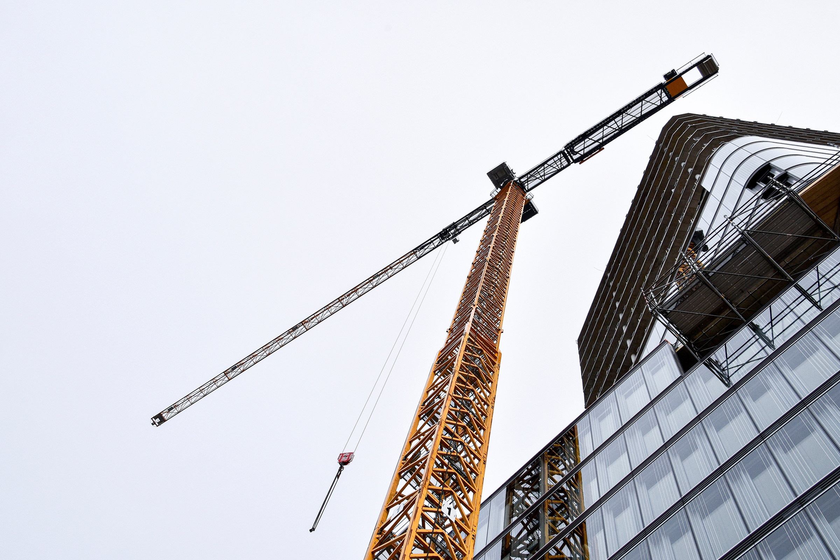

AI-BASED STRUCTURAL HEALTH MONITORING (SHM) IN CIVIL ENGINEERING
Presented by:
Dhanush Prabhu
221CV119
Department of Civil Engineering, NITK
1

Slide 2

Abstract
This presentation explores the use of Artificial Intelligence (AI) in Structural Health Monitoring (SHM).
Discusses various AI technologies, sensor integration, real-world applications, and future trends.
Emphasis on the transition from manual inspections to predictive, data-driven maintenance in civil structures
2

Slide 3

Introduction
What is Structural Health Monitoring (SHM)?
SHM is the process of implementing a damage detection strategy for civil structures like bridges, buildings, and dams.
It involves continuous or periodic monitoring using various sensors and technologies to assess the condition of a structure over time.
Why SHM is Important?
Ensures safety and functionality of critical infrastructure.
Helps in early detection of damage, preventing catastrophic failures.
Reduces maintenance costs and improves decision-making for repairs.
Role of AI in SHM
AI techniques help analyze massive data collected from sensors.
Machine Learning and Deep Learning models identify patterns and anomalies that human inspection might miss.
Enables real-time, automated assessment of structural conditions.
3

Slide 4
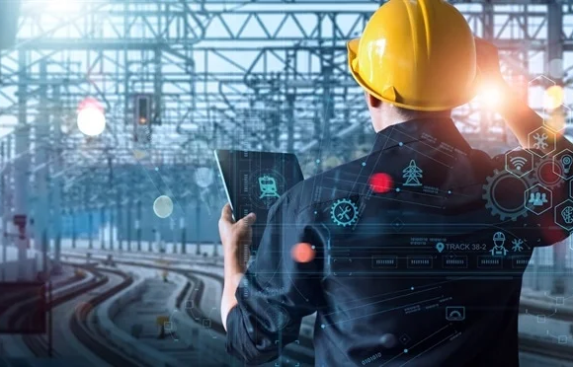
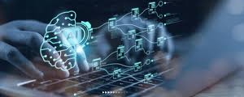
AI Technologies in SHM
Machine Learning (ML): Learns from historical and real-time data to detect and classify structural anomalies.
Deep Learning (DL): Especially Convolutional Neural Networks (CNNs) for image recognition and pattern detection in visual inspections.
Reinforcement Learning (RL): Helps in optimizing maintenance schedules by learning from system performance.
Natural Language Processing (NLP): Extracts insights from inspection reports, maintenance logs, and human-entered records.
Computer Vision: Automates defect detection from visual inputs captured by cameras or drones.
4

Slide 5
AI and Sensor Integration in SHM
Civil structures are embedded with various sensors including strain gauges, accelerometers, displacement sensors, and fibre optic systems.
AI processes large datasets from these sensors to detect hidden anomalies, degradation, or unusual patterns.
IoT technology enables seamless data collection and transmission, while cloud and edge computing support real-time analysis and alert generation.
5

Slide 6
AI Applications – Bridges and Buildings
Bridges: AI models analyze stress, fatigue, and vibration data to prevent failure due to overloading, fatigue, or environmental conditions.
Buildings: High-rise structures use AI to monitor sway, tilt, and differential settlement, especially in seismic zones where real-time updates can inform evacuation and response.
Both cases benefit from AI's predictive abilities that alert engineers before serious damage occurs.
6

Slide 7
AI Applications – Dams, Tunnels, and Heritage Sites
Dams: AI analyzes seepage trends, pressure buildup, and foundation shifts, helping in avoiding catastrophic floods.
Tunnels: Deep-learning models detect soil movement, excessive vibration, and structural stress in underground environments.
Heritage Structures: Non-invasive AI-based SHM protects ancient buildings by tracking micro-cracks, moisture, and environmental wear without causing damage.
7

Slide 8
Case Study – IIT Mandi & INRIA Bridge Monitoring
AI algorithms processed vibration and strain data collected from bridges in Himachal Pradesh.
ML models helped predict fatigue accumulation and prioritized inspection zones.
The project reduced the need for frequent manual inspection and demonstrated cost-effective maintenance planning through predictive SHM.
8

Slide 9
Case Study – Drone Inspection of Infrastructure
Drones equipped with AI-driven computer vision were deployed to inspect remote and tall structures like towers and facades.
The AI analyzed high-resolution images to detect surface cracks, corrosion, and deformation without needing scaffoldings or physical access.
The method proved safer, faster, and provided more frequent insights than traditional inspection methods.
9

Slide 10
Case Study – Tokyo Skytree Monitoring
AI-based SHM system in Tokyo Skytree used accelerometers and sensors to monitor structural response to wind and seismic events.
Real-time vibration monitoring allowed detection of oscillation patterns and ensured public safety in a high-rise environment.
Enabled prompt decision-making and efficient maintenance based on live sensor feedback.
10

Slide 11
Advantages of AI-Based SHM
Early Fault Detection
High Accuracy and Reduced Human Error
Predictive Maintenance
Cost Savings Over Time
Real-time Monitoring and Alerts
Improved Public Safety and Risk Management
11

Slide 12
Challenges and Limitations
High initial cost of sensors and systems
Need for skilled AI professionals
Issues with data overload
Sensor reliability and environmental resilience
Model generalization across diverse structures
Privacy and ethical concerns
12

Slide 13
Future Prospects
Digital Twins of real-time structures
5G and Edge AI integration
Self-healing Smart Materials
Autonomous Drones and Robots
Blockchain for Data Security
AI-guided Sustainable Design
13

Slide 14
Conclusion
AI is revolutionizing SHM, enabling smart, safe, and sustainable infrastructure.
The integration of AI and IoT provides proactive monitoring, reducing risks and costs.
Continued research will refine models, improve adaptability, and expand use cases.
14

Slide 15
References
Mdpi.com – "AI and IoT in Structural Health Monitoring: A Review"
Constructionworld.in – "IIT Mandi Develops AI Model for Bridge Monitoring"
ResearchGate – "Application of Deep Learning in Structural Defect Detection"
NCBI – "Smart Cities and AI-Based Infrastructure Monitoring"
IEEE Xplore – "AI in Civil Engineering: Structural Applications and Trends"
Elsevier – "Recent Developments in Sensor Integration for AI-Enabled SHM"
Springer – "Digital Twins and AI for Smart Construction"
15

Slide 16

THANK YOU
16

